Slide 1
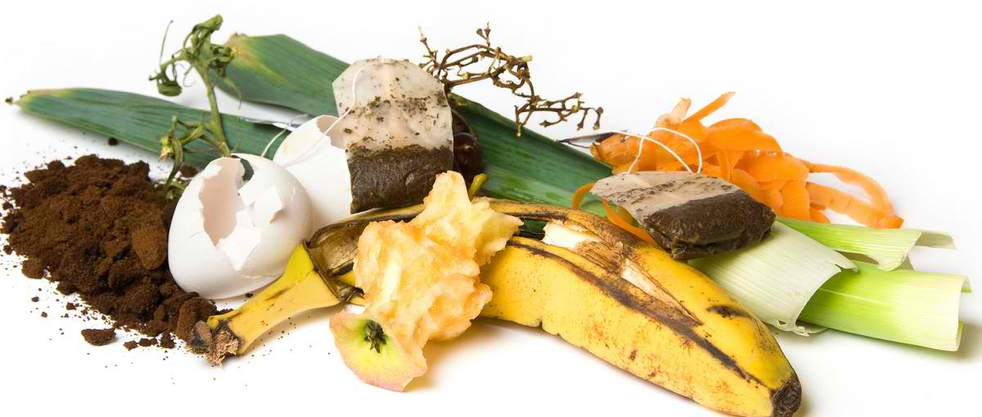
Automated Household
Food Waste
Composting Machine

Slide 2
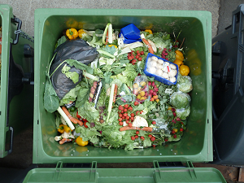
Problems
Food Waste
  Food is everywhere and as long as food exists, wastes are also evident. Better if these food waste be converted into something usable
Pollution
  The improper disposal of the food waste results to a larger problem which is pollution (in the air, water, and soil)
Composting Fertilizers
  The excessive and inappropriate use of chemical fertilizers in crop soils cause land degradation and losses in soil fertility.

Slide 3
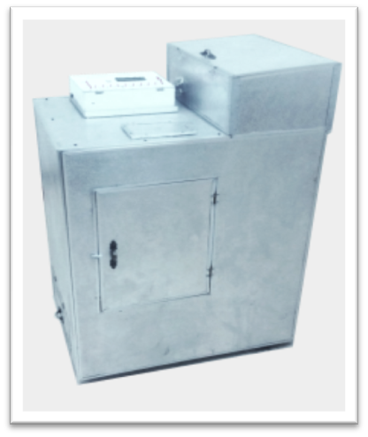
Solution
The project is very helpful to the urban families in reducing their household waste. Management of the garbage will be materialized in an eco-friendly way. They can use the product of the project in their grounds to fertilize the plants. It will also serve as a learning tool for householders in examining the different techniques in composting.
Electronic Composting Machine

Slide 4

Market
The market is for every household, locally and globally that would like to manage and utilize all the food waste and transform it into usable and environment-friendly compost

Slide 5
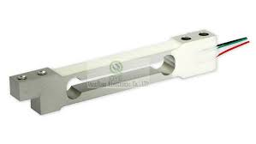
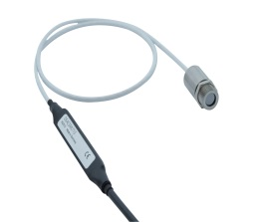
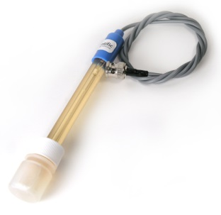
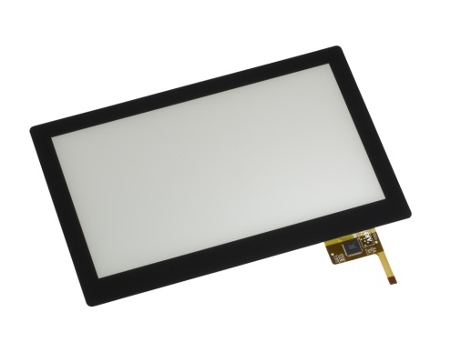
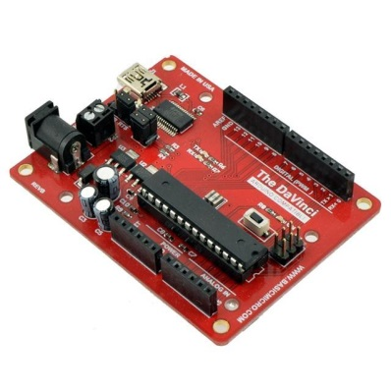
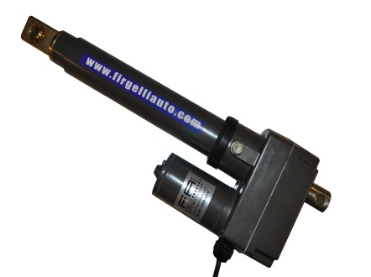
Technology
The project uses electronic devices such as:
Sensor
(weight, temperature, ph level)
Touch Screen
for Graphical User Interface
Microcontroller
Actuators

Slide 6
- ITITE -
Innovations Through Information Technology and Engineering
Ms. Shella Lou Ibon
Engr. Noel Anonas
Engr. Duwi Iscala
Engr. Rossmel Lingon

